Slide 1
C Programming
Pointers

Slide 2
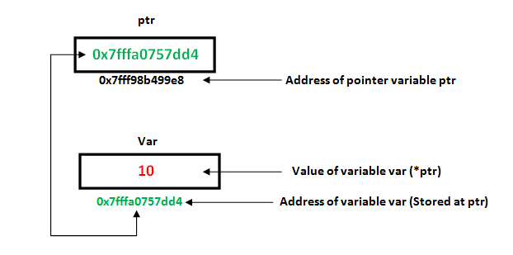
What Are Pointers?
A pointer is a variable whose value is the address of another variable, i.e., direct address of the memory location.

Slide 3
Declaration Of Pointer:
int *ip; /* pointer to an integer */
double *dp; /* pointer to a double */
float *fp; /* pointer to a float */
char *ch /* pointer to a character */
The actual data type of the value of all pointers, whether integer, float, character, or otherwise, is the same, a long hexadecimal number that represents a memory address.
The only difference between pointers of different data types is the data type of the variable or constant that the pointer points to.

Slide 4
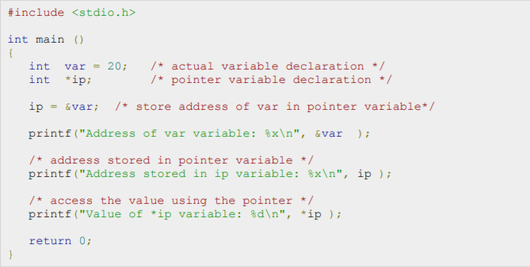
How to Use pointers:

Slide 5
Program Explained:
int var = 20; A variable declared of type integer
int *ip; A pointer declared of same type of that variable
ip = &var; store address of var in pointer variable
& - to get the address of the variable
printf("Address of var variable: %x\n", &var ); print the address of the variable
Print the hexadecimal characters

Slide 6
Continued ...
printf("Address stored in ip variable: %x\n", ip );
address stored in pointer variable
printf("Value of *ip variable: %d\n", *ip );
access the value using the pointer

Slide 7

Output:

Slide 8
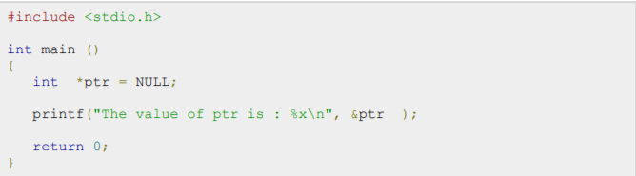
Null Pointers In C:
It is always a good practice to assign a NULL value to a pointer variable in case you do not have exact address to be assigned.
This is done at the time of variable declaration.
A pointer that is assigned NULL is called a null pointer.

Slide 9
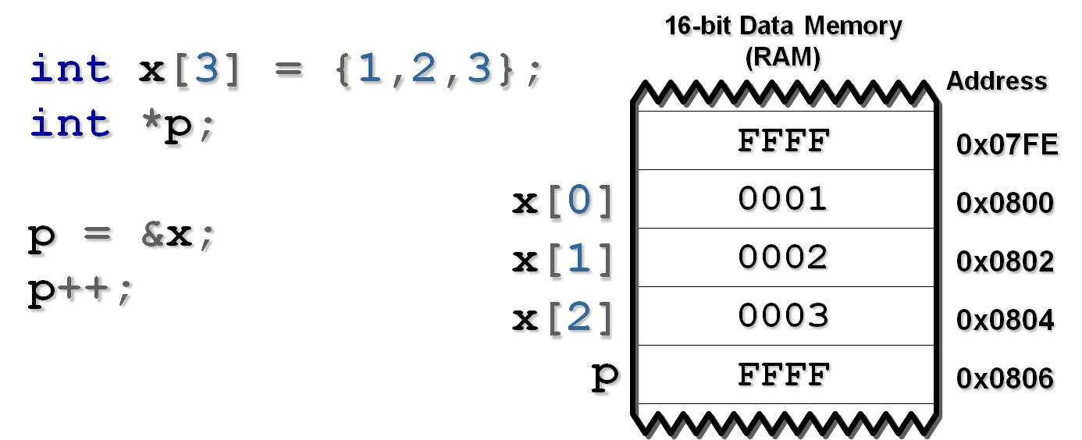
Arithmetic Operations In pointers:
you can perform arithmetic operations on a pointer just as you can a numeric value.
There are four arithmetic operators that can be used on pointers: ++, --, +, and -
let us consider that ptr is an integer pointer which points to the address 0x0800.
Whenever the pointer is incremented the address is incremented by 2 BYTES

